Slide 1
4th National Workshop on Machine Learning and Data Science
September 15-19, 2021

Slide 2
Workshop Group I
Day 1 : Web Scraping using BeautifulSoup
Day 2 : Data Analysis and Visualization
Day 3 : Forecasting Algorithms
Day 4 : Flask Web App

Slide 3
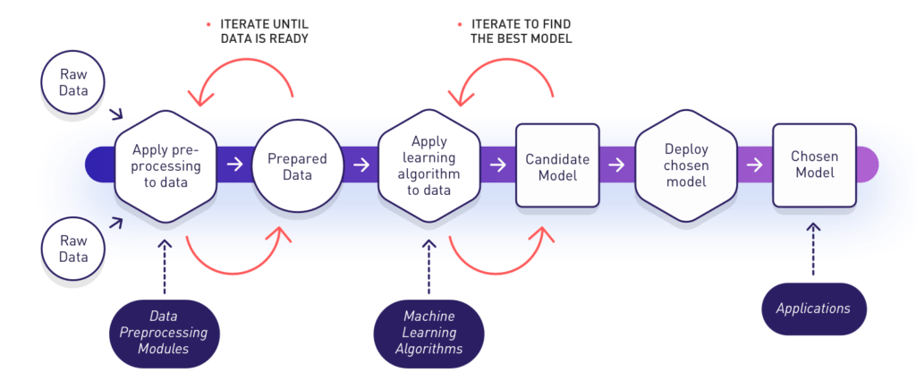
Road Map For Prediction Applications

Slide 4
Web Scraping and BeautifulSoup
DAY 2
September 16
Mentor
Ashish Tiwari
Nischal Shrestha
Poshan Pandey

Slide 5
Web Scraping and BeautifulSoup
Internet is rich with so much data, and apparently, data has become the new oil
Web scraping deals with extracting or scraping the information from the website

Slide 6
BeautifulSoup
Beautiful Soup is a pure Python library for extracting structured data from a website.
Uses parsers like lxml and html5lib
Faster
Easier

Slide 7
Parsers (lxml)
Way of navigating, searching and modifying parse tree
Modules like prettify, objectify and many more…

Slide 8
Requests
Requests is a simple, yet elegant
allows you to send HTTP/1.1 requests extremely easy, HTTP library
Requests is one of the most popular Python package today

Slide 9
4th National Workshop on Machine Learning and Data Science
September 16, DAY 2
Group I
Mentor
Ashish Tiwari
Nischal Shrestha
Poshan Pandey

